Slide 1
An Open-Source and Reproducible Implementation of LSTM and GRU Networks for Time Series Forecasting
Gissel Velarde, Pedro Brañez, Alejandro Bueno,
Rodrigo Heredia, and Mateo Lopez-Ledezma
Independent, Bolivia
Presented at the 8th International Conference on Time Series and Forecasting ITISE 2022, 27th-30th June, Gran Canaria, Spain

Slide 2
Why open-source?
We found it challenging to compare our own work with closely related studies
Methods were described but implementations were not shared
Datasets were not available
Reproducible research
G. Velarde et al.

Slide 3
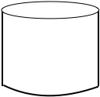
Summary
Activities
10 time series
RMSE
Root Mean Squared Error
DA
Directional Accuracy
Visual inspection
Forecasting
Evaluation
Baseline
1 and 20-step ahead
LSTM
Long Short-Term Memory
Stock market
10 time series
GRU
Gated Recurrent Unit
G. Velarde

Slide 4
Literature review
Recurrent Neural Networks (RNNs) model dependencies over time.¹
LSTM outperforms Autoregressive Integrated Moving Average (ARIMA).²
From various deep learning models, LSTM & GRU deliver low RMSE.³
1. Rumelhart, D.E., Hinton, G.E., Williams, R.J.: Learning representations by back-propagating errors. Nature 323 (6088), 533–536 (1986) .
2. Siami-Namini, S.; Tavakoli, N.; Namin, A.S. A comparison of ARIMA and LSTM in forecasting time series. 2018 (ICMLA). IEEE, 2018.
3. Balaji, A.J.; Ram, D.H.; Nair, B.B. Applicability of deep learning models for stock price forecasting an empirical study on BANKEX data. Procedia computer science 2018.
G. Velarde et al.

Slide 5
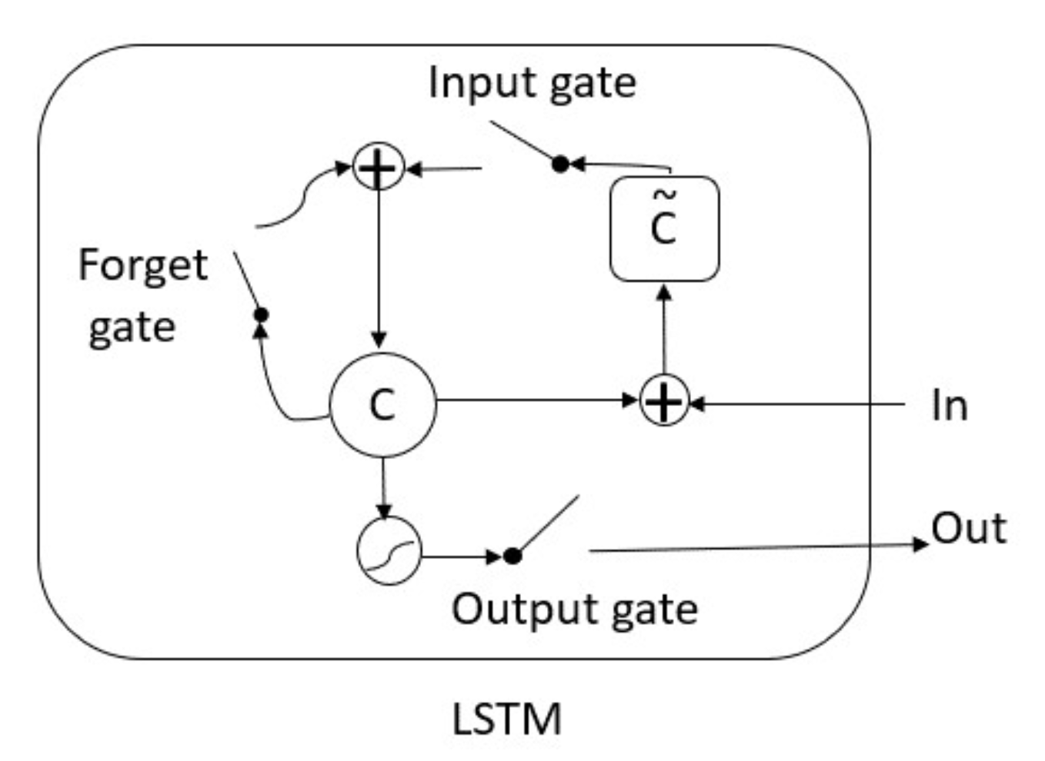
LSTM [1]. c represents the memory cell and c ̃ the new memory cell of the LSTM. Based on [3].
Hochreiter, S.; Schmidhuber, J. 1997
3. Chung, J.; Gulcehre, C.; Cho, K.; Bengio, Y. 2014
G. Velarde et al.

Slide 6
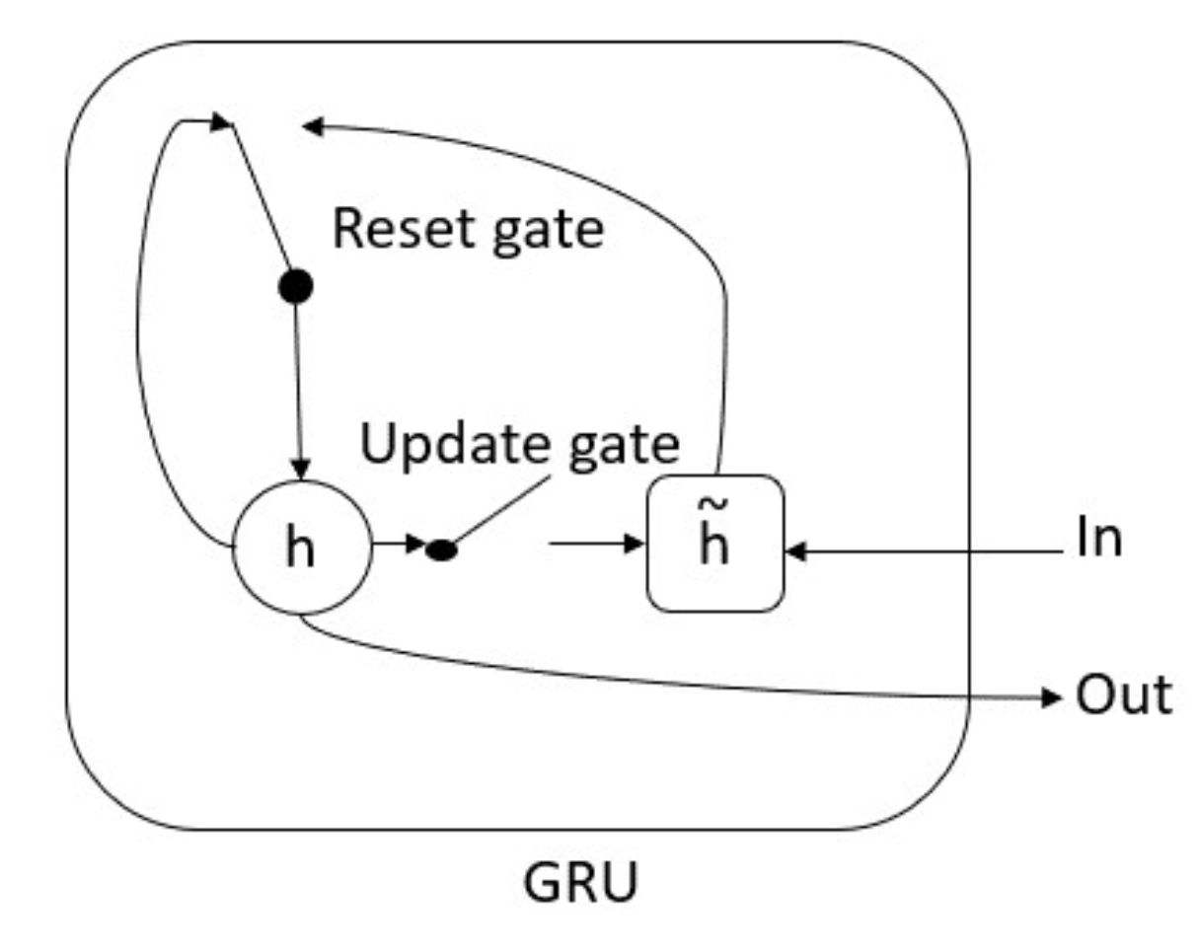
GRU [2]. h represents the activation and h ̃ the new activation of the GRU. Based on [3].
2. Cho, K.; Van Merriënboer, B.; Bahdanau, D.; Bengio, Y. 2014
3. Chung, J.; Gulcehre, C.; Cho, K.; Bengio, Y. 2014
G. Velarde et al.

Slide 7
Method
Root Mean Squared Error
RMSE
Directional Accuracy
DA
Data Preparation
Model training
Evaluation on
the test set
Unnormalization
Normalization
- A layer with 128 units - A dense layer with
f-steps ahead
- Recurrent sigmoid and tanh activations
- 200 epochs
- Adam optimizer
- Loss function Mean
Squared Error (MSE)
f-steps ahead
Define Train and Test
set partition
Visual inspection
Select one time series
to train the network
G. Velarde

Slide 8
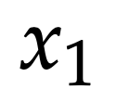
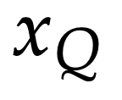
A selected time series:
…
G. Velarde et al.

Slide 9
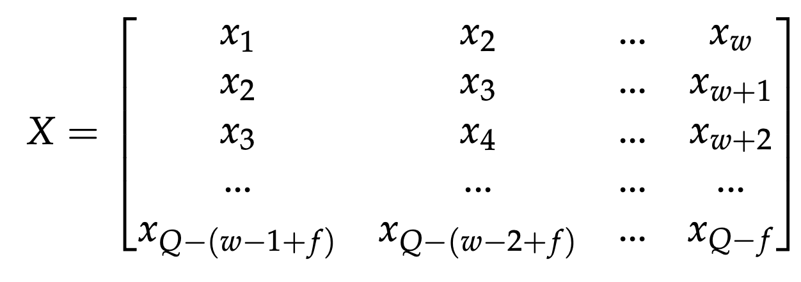
Train
Targets
Test
Targets
N training samples
Q time series samples
G. Velarde et al.

Slide 10
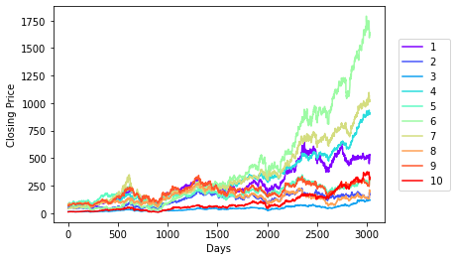
BANKEX Dataset
Closing Price in Indian Rupee (INR).
Daily samples retrieved between 12 July 2005 and 3 November 2017
All time series with 3 032 samples
G. Velarde et al.

Slide 11
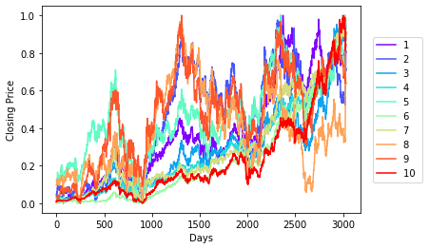
BANKEX Dataset Normalized
Daily samples retrieved between 12 July 2005 and 3 November 2017
All time series with 3 032 samples
G. Velarde et al.

Slide 12
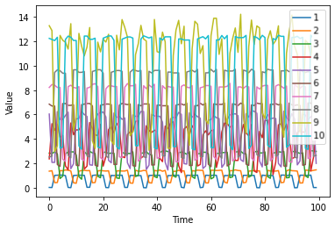
Activities Dataset
Synthetic dataset. First 100 samples. 3 584 samples per series
G. Velarde et al.

Slide 13
Evaluation
G. Velarde et al.

Slide 14
Evaluation
G. Velarde et al.

Slide 15
Close-to-Zero RMSE and Close-to-One DA are preferred.
G. Velarde et al.

Slide 16
Close-to-Zero RMSE and Close-to-One DA are preferred.
G. Velarde et al.

Slide 17
An example of 1-step ahead forecast. Actual and predicted closing price over the first 100 days of the test set Yes Bank. Closing Price in Indian Rupee (INR).
G. Velarde et al.

Slide 18
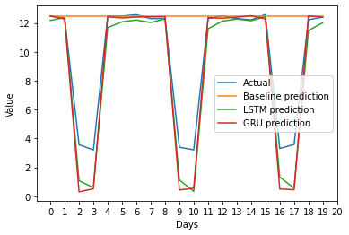
BANKEX dataset
Activities dataset
Examples of 20-step ahead forecast.
G. Velarde et al.

Slide 19
Conclusion
The networks can be successfully trained with a single time series:
If the dataset contains patterns that repeat, even with certain variation.
We failed to find an architecture that would outperform a baseline on stock market data.
Either the method is not appropriate, or
some information is not reflected in stock market series alone.
G. Velarde et al.

Slide 20
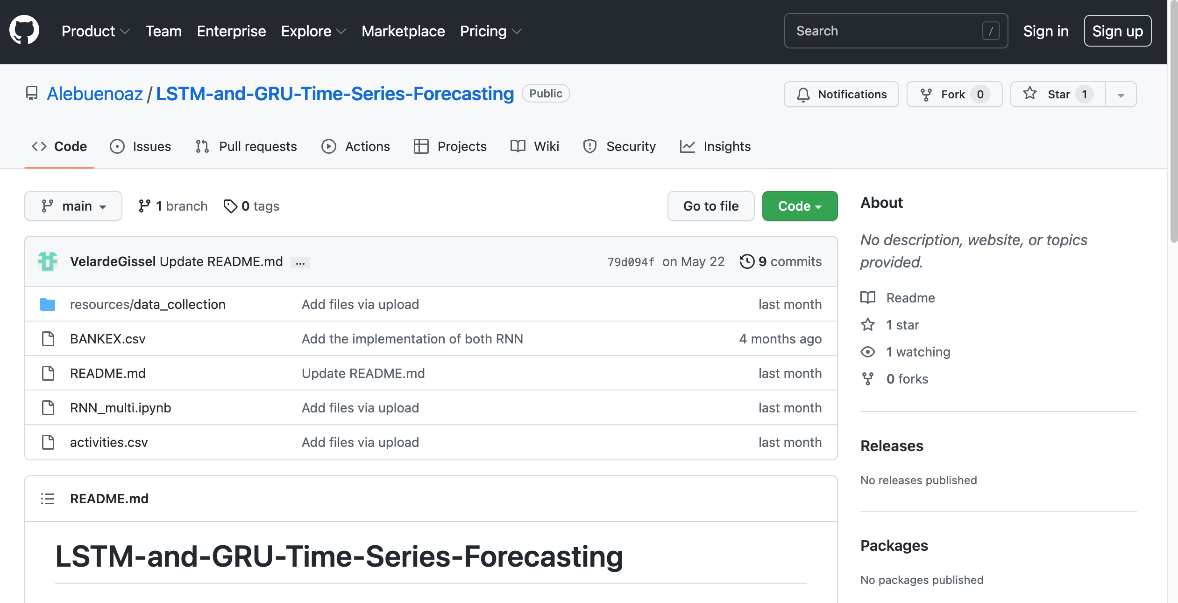

Slide 21
RNN_multi.ipynb

Slide 22
Implementation, datasets & experiments
The paper
https://github.com/Alebuenoaz/LSTM-and-GRU-Time-Series-Forecasting
https://www.mdpi.com/2673-4591/18/1/30/htm
G. Velarde et al.

